Slide 1

JSON Schema Validation

Slide 2
JSON Schema Validation
Defining the structure of JSON data
JSON Schema is a vocabulary that allows you to annotate and validate JSON documents
Most basic schema is a blank JSON object {}
{ "type": "object" }

Slide 3
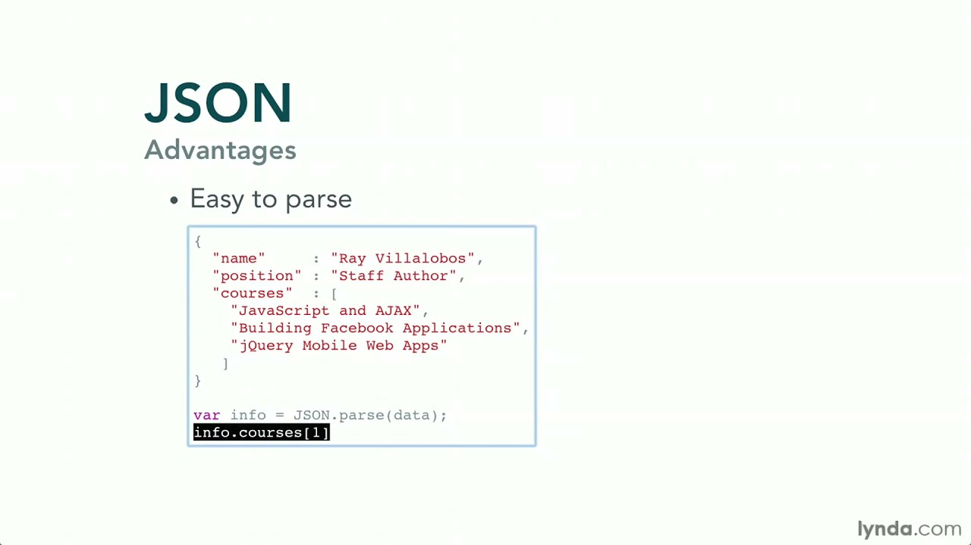
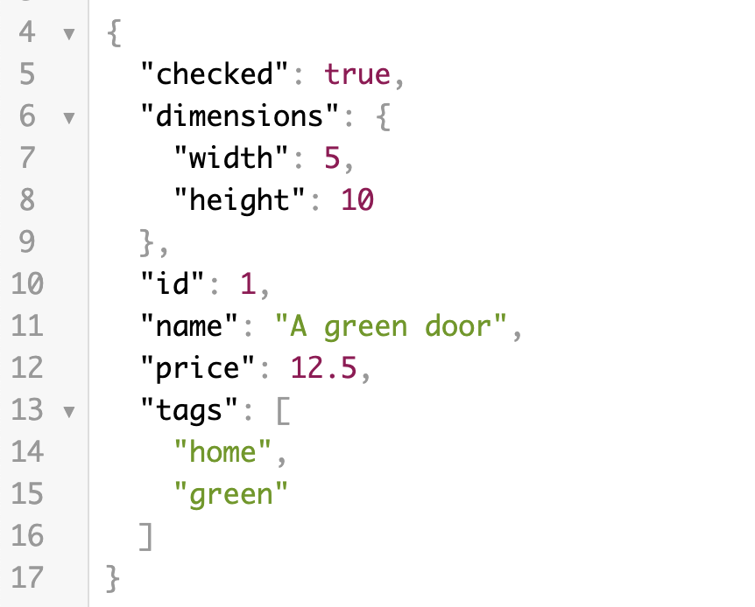
What is JSON?

Slide 4
What we can check in JSON Schema
1. We can check for the type of fields and fail the test if Type is different
2. We can check for required fields
3. We can check the number of min propteroes should come in response
4. We can verify with example data.

Slide 5
What we can check in JSON Schema
5. If we have additionalProperties : false, So Schema validation will fail if we have extra key added to response.
6. banUnknownProperties is will the test if you have unknown or extra field like additonalProperties
"7. You can use the Regex also in Properties like to verify field data type (e.g I am checking if property proBinaryName has .exe or not)
{
""type"": ""object"",
""properties"": {
""progBinaryName"": {
""type"": ""string"",
""pattern"": ""^[A-Za-z0-9 -_]+_Prog\\.(exe|EXE)$""
}
}
}"

Slide 6
How to do it in Postman
1. Copy the response to these sites
// Create the Schema using jsonschema.net
// another tool - https://easy-json-schema.github.io/
// https://www.liquid-technologies.com/online-json-to-schema-converter"
2. create a variable like this
var schema = {); put into it
3. Use Tiny validate to verify with reponse data.
pm.test('JSON Schema', function() {
var jsonData = pm.response.json();
pm.expect(tv4.validate(jsonData, schema)).to.be.true;
});

Slide 7
How to do it in Postman
In POSTMAN
https://www.getpostman.com/collections/e41482d4eb033b7c47b7

Slide 8
JSON Schema
{}
{ "type": "string" }
{ "$schema": "http://json-schema.org/schema#" }
"minLength": 2,
"maxLength": 3
"pattern": "^(\\([0-9]{3}\\))?[0-9]{3}-[0-9]{4}$"
Properties
Required
items

Slide 9
JSON Schema
https://www.jsonschemavalidator.net/
https://www.jsonschemavalidator.net/s/hG6wNqk4
https://ajv.js.org/keywords.html
https://www.jsonschema.net/app/schemas/0
https://www.jsonschemavalidator.net/

Slide 10
How to do in REST ASSURED?
<dependency>
<groupId>io.rest-assured</groupId>
<artifactId>json-schema-validator</artifactId>
<version>4.3.1</version>
</dependency>
Adding maven dependency of json-schema-validator

Slide 11
How to do in REST ASSURED?
<dependency>
<groupId>io.rest-assured</groupId>
<artifactId>json-schema-validator</artifactId>
<version>4.3.1</version>
</dependency>
Adding maven dependency of json-schema-validator
import io.restassured.module.jsv.JsonSchemaValidator;
JsonSchemaValidator.matchesJsonSchemaInClasspath("AuthJsonSchema.json")

Slide 12
How to do in REST ASSURED?
https://github.com/PramodDutta/JsonSchemaValidationRestAssuredDemo
https://reqres.in/api/users/2

